Slide 1
Booting from hard disk…
Starting Windos 95...
Press me

Slide 2


Slide 3
X

Slide 4
Coming soon
X
The dev has not made this feature yet!
Be patient!

Slide 5

Access denied
X
Your admin has denied access to this element of Windos.
Contact them about this if you still want to access it.

Slide 6
X

Slide 7

X

Slide 8

File Explorer
X

Slide 9
login
Username: username
Password: ********
Log in

Slide 10





Windos 95
Alpha 5
For testing purposes only
What’s new:
This is the last alpha version of this OS!
Windos will have an online website soon!
Added sticky notes
Added 1 new website
Created shortcuts widget
Shortcuts:
Explorer
Intranet
Email
Feedback
All apps
Hint of version:
Please do get an older version of Windos from the Windos website!

Slide 11
All apps
Explorer
Run
Find
Intranet explorer
Log off Username
Power off…

Slide 12
Power menu
X
Power off
Reboot
Log off
sleep

Slide 13
It is now safe to turn off your computer.
Restart
Press ESC to exit Windos now

Slide 15




All apps
X
Intranet explorer
Sticky notes
Minecraft
email
explorer
Fortnite

Slide 16
Intranet explorer 16- CONNECTED
X
Welcome to the Intranet!
Tap on any of the underlined text to open that website!
Windos official site
Google
Bing
Ask Jeeves

Slide 17

File Explorer
X
My computer
C:\

Slide 18
run
X
osod.exe
✓
X

Slide 19
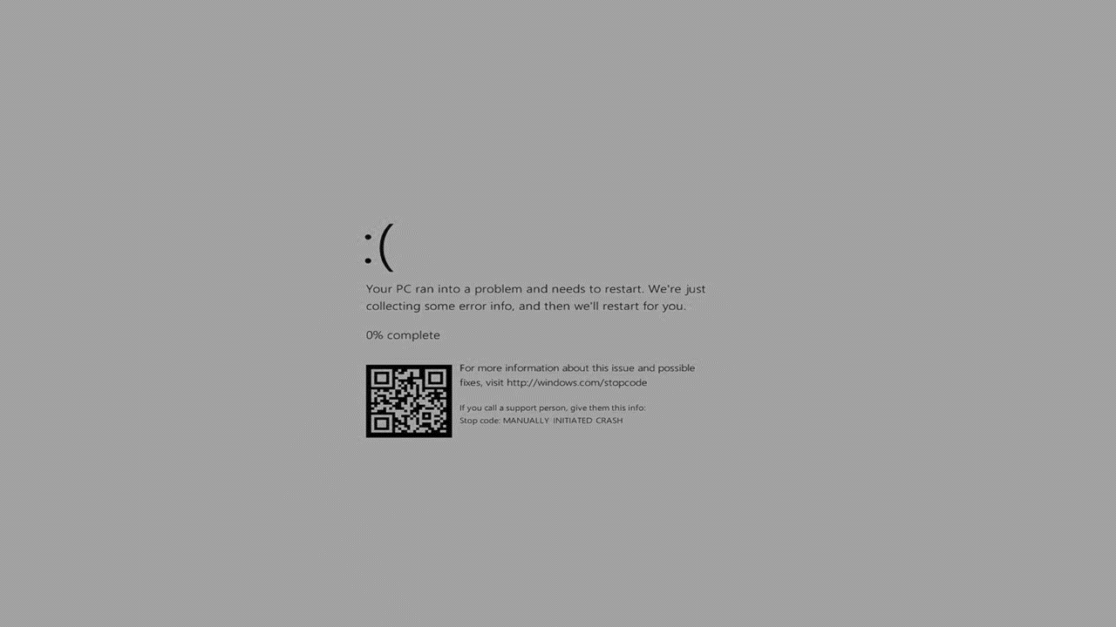

Slide 20

find
X
osod.exe
Found 1 file:
osod.exe
Press the button to open file

Slide 21

File Explorer
X
C:\
Windos
Program files
Windos.dll

Slide 22
Access denied
X
This PC has denied access to this file or folder.
Please contact the developer of Windos for ,more info.

Slide 23
Windos.com
X
Windos official site!
Welcome to the official site of Windos!
The latest official build is Windos 3 v1.01 but you can get Windos 95 alpha 3!
request a copy!
Feedback
Contact the developer

Slide 24
Windos. Com/copyrequest.html
X
Copy request:
Windos official site!
Windos 1 latest
Windos 2 latest
Windos 3 latest
Windos 95 latest alpha
Windos 95 waiting list
Request all Windos 1
Request all Windos 2
Request all Windos 3

Slide 25

Minecraft
X

Slide 26



Ew this game sucks
X

Slide 27
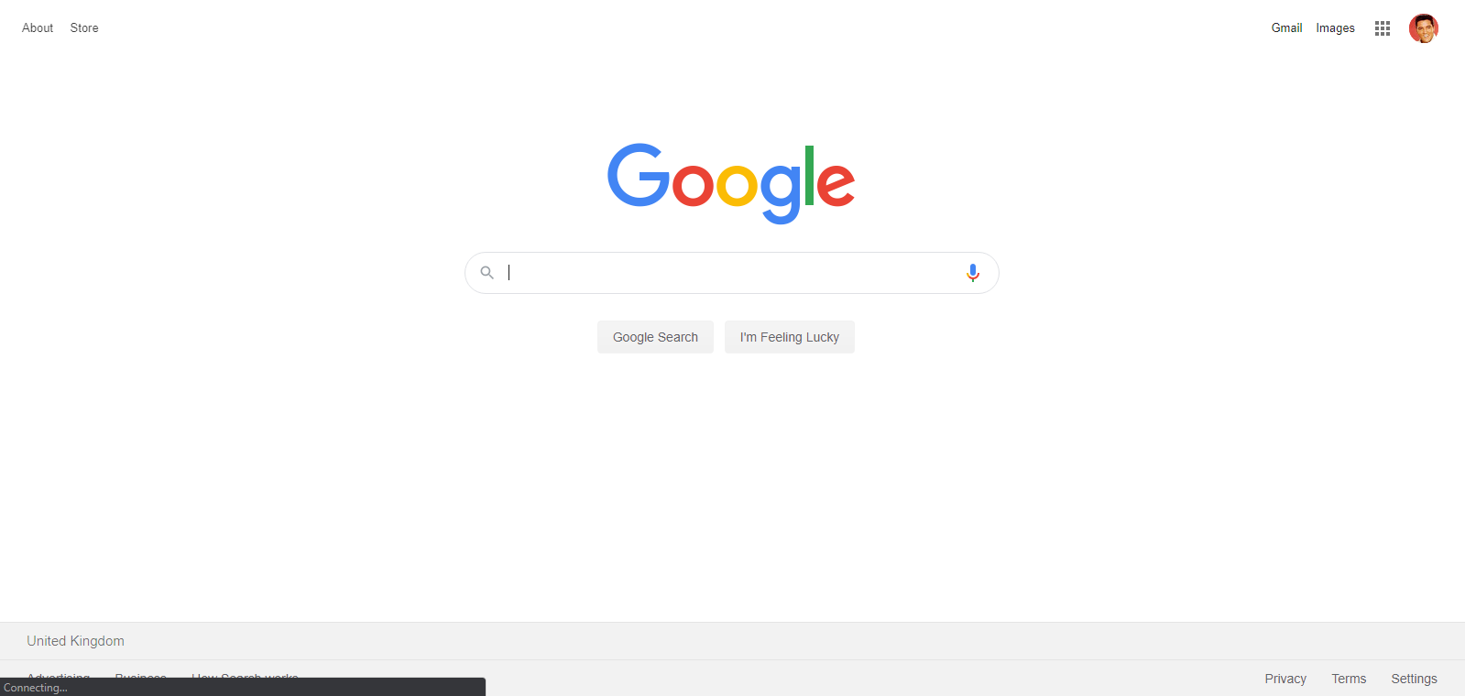
Google.com
X
Welcome to an archive of Google.com from 03/06/2020

Slide 28
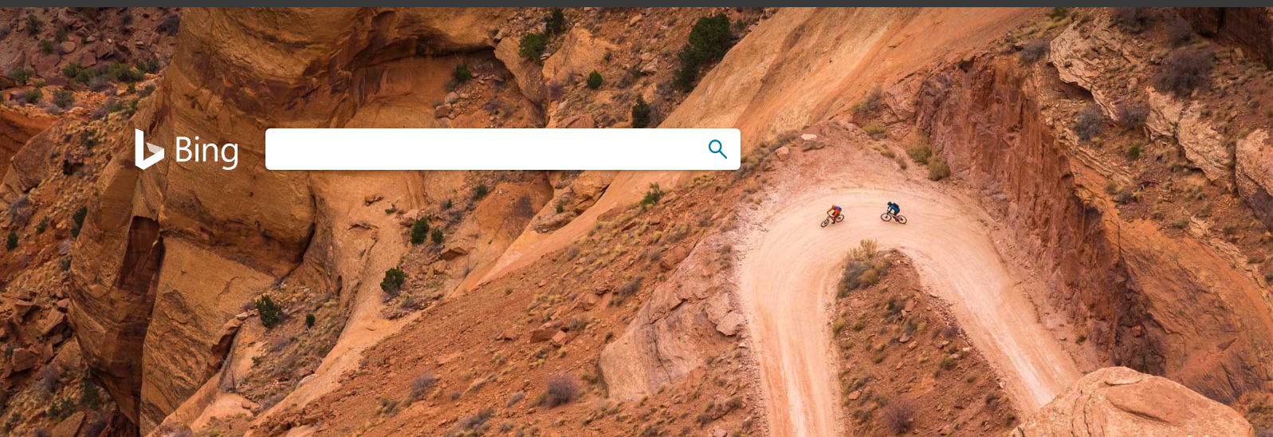
Bing.com
X
As of 3/6/2020

Slide 29

Ask-jeeves.com
X

